Slide 1
TO LET Retail Unit
1-2 Sainsbury Centre, Darkes Lane
Potters Bar, EN6 1AU
Prominent location
Planning Use Class E
Size - 1,337 sq ft
Quoting Rent £27,500 per annum
Ella Traynor – 07958 028582
ella.traynor@rapleys.com
Rob Fraser – 07894 605513
rob.fraser@rapleys.com

Slide 2
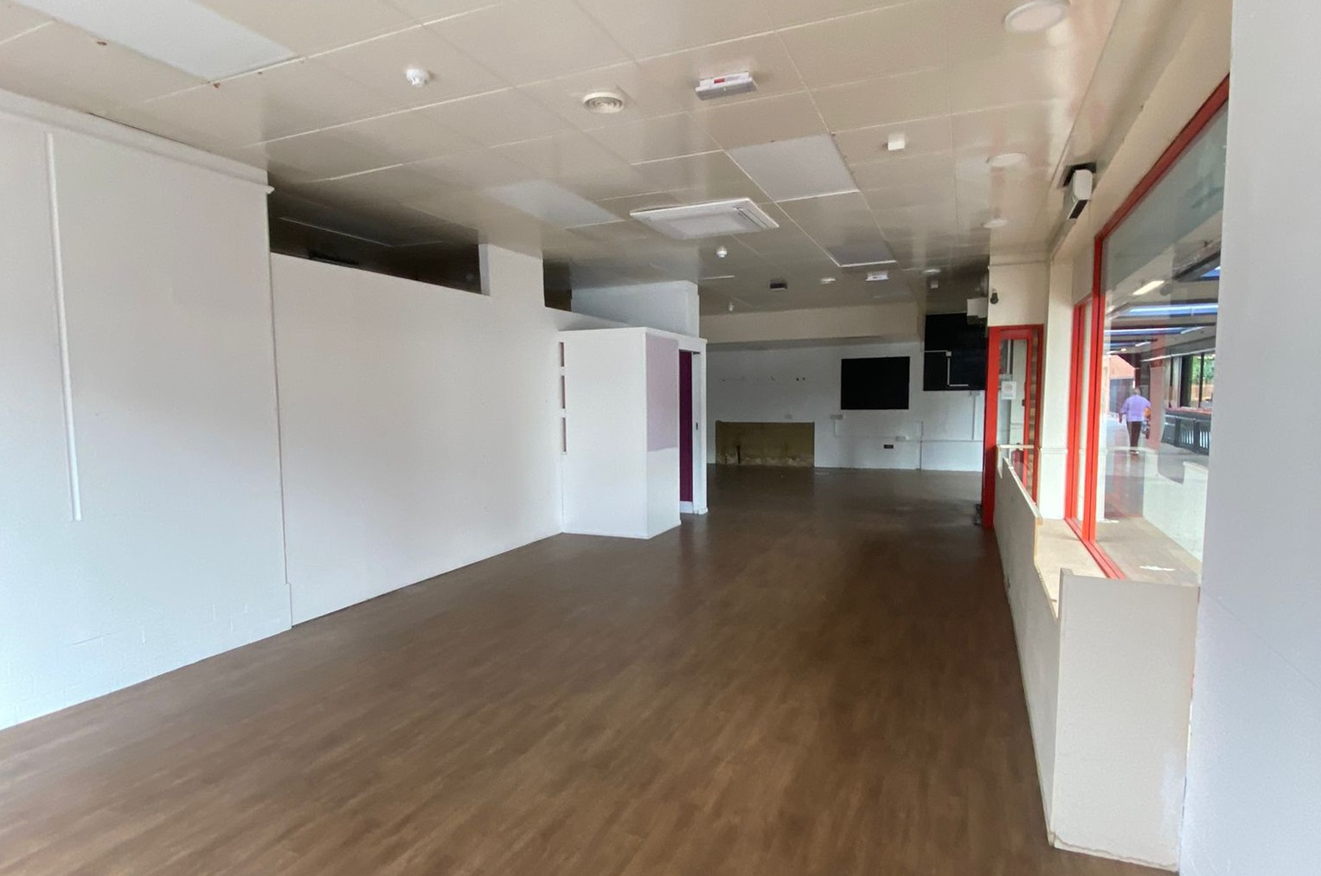
Location
Potters Bar is a town located in Hertfordshire, 13 miles north of central London. The town is a popular commuter town, with a population of 21,640 approximately.
The property is located within the town centre on the High Street, a 3 minute walk from Potters Bar Railway Station. Other occupiers include Holland & Barrett, Costa, Card Factory, Boots and Caffe Nero.
Accommodation
The premises are arranged over the ground floor providing the following approximate internal floor areas:-
Energy Performance Rating
Energy Performance Asset Rating - C. A certificate can be made available.
Planning
The premises falls within Class E of the Town & Country Planning (Use Classes) Order 2020.
Interested parties should carry out their own due diligence in this regard.
Terms
Available by way of a new lease on terms to be agreed. Lease to be contracted out of the Landlord & Tenant Act security provisions.
Tenure
£27,500 per annum.
Service Charge
£3,663.35 pa, subject to annual review.
Legal Costs
Each party is to be responsible for their own legal costs incurred in the transaction.
VAT
All figures quoted are exclusive of Value Added Tax which will be charged at the prevailing rate.
Identity Checks/AML
The Money Laundering Regulations require us to conduct checks upon all Prospective Parties. Prospective Parties will need to provide proof of identity and residence. For a Company, any person owning more than 25% must provide the same.
To add another of these pages, right-click on thumbnail to the left and then select “Duplicate Slide”. The page number will automatically update on the new page
 | Sq m | Sq ft
Ground | 124.21 | 1,337
Total | 124.21 | 1,337
Note: The above areas have been calculated in accordance with the RICS Code of Measuring Practice on an approximate net internal basis and must be verified by interested parties.

Slide 3
Rating
We are advised that the Rateable Value for the property is £24,750.
The UBR for 2024/25 is 49.9p in the £.
Interested parties are advised to make their own enquiries to the local authority regarding the rates liability and any reliefs that may be available.
Further information is also available at www.gov.uk/calculate-your-business-rates.
Viewing
Strictly via the sole letting agent only.
Additional Information
The link below provides access to the Sainsbury’s UK Property Website which provides full details on all our Sainsbury’s / Argos disposals.
Sainsbury's Property Disposals

Slide 4
About us
Rapleys is an action-oriented property consultancy, offering building consultancy, commercial, planning and residential property services, operating from seven offices across the UK:
Birmingham
Bristol
Cambridge
Cardiff
Edinburgh
Huntingdon
London
Manchester
CAN RAPLEYS HELP WITH THE BELOW ADDITIONAL PROPERTY SERVICES?
Ella Traynor – 07958 028582
ella.traynor@rapleys.com
Industries
Services
Rob Fraser – 07894 605513
Automotive & Roadside
Care & Retirement
Charities/Not-for-Profit
Data Centres
Education
Health & Animal Welfare
Industrial & Logistics
Life Sciences
Local Authority
Offices
Renewables
Residential
Retail & Leisure
Transport & Infrastructure
Building Consultancy
Commercial Agency
Compulsory Purchase
Cost Management
Development Agency & Consultancy
Environmental Impact Assessment
Investment
Lease Consultancy
Neighbourly Matters
Project Management
Property Management
Rating
Strategic Land
Town Planning
Valuation
Viability/Affordable Housing
rob.fraser@rapleys.com
CREATIVE I PROACTIVE I CONNECTED

